Slide 1


Slide 2
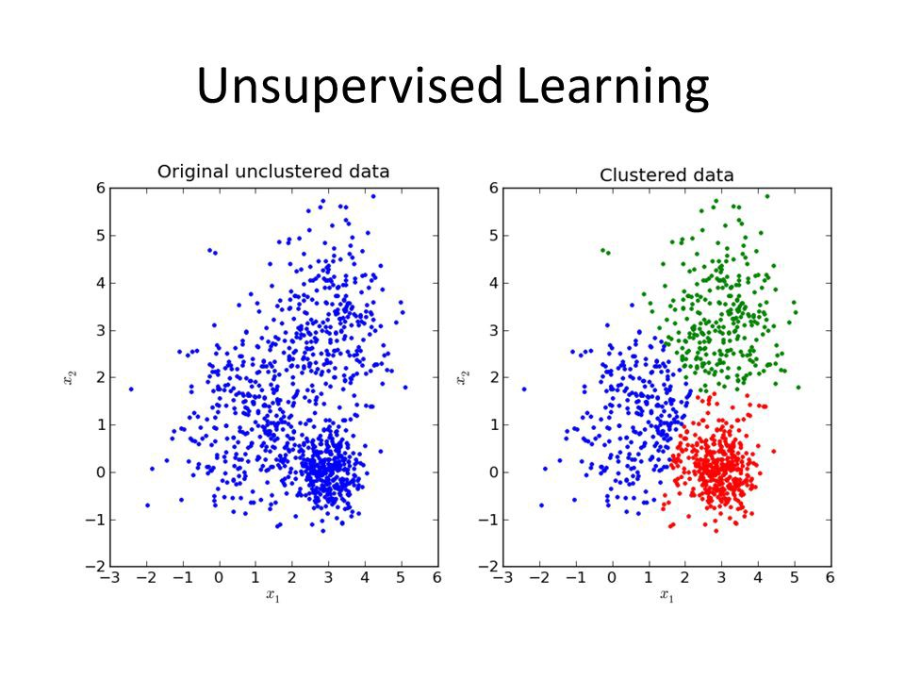

Slide 3
Types of Unsupervised Learning
Clustering
Dimensionality Reduction

Slide 4
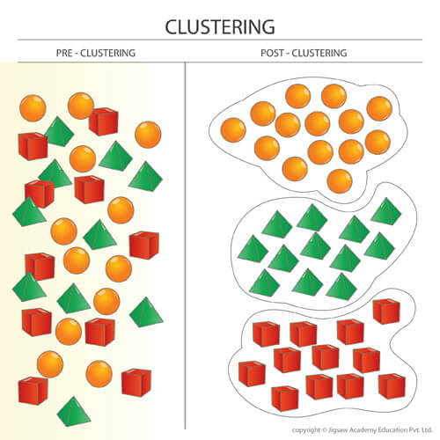
Clustering is the task of dividing the population or data points into a number of groups such that data points in the same groups are more similar to other data points in the same group than those in other groups.

Slide 5
Clustering Methods
Density-Based Methods
Hierarchical Based Methods
Agglomerative
Divisive
Partitioning Methods

Slide 6
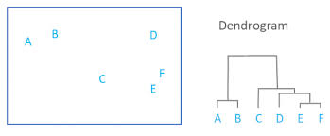
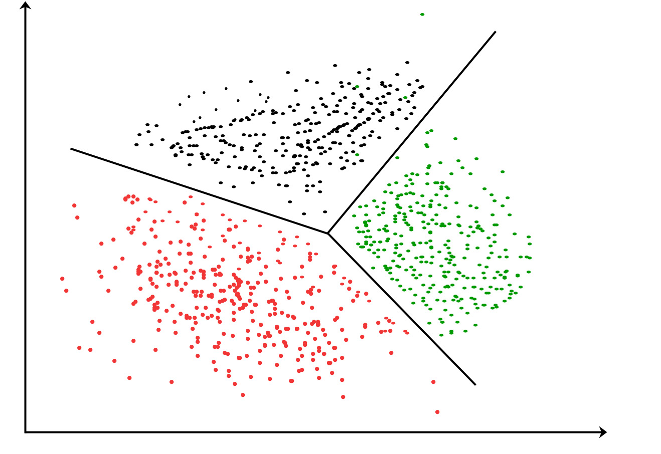
Clustering Algorithms
K-mean Clustering
Hierarchical Clustering

Slide 7
Dimensionality reduction
It is the process of reducing the number of random variables under consideration, by obtaining a set of principal variables

Slide 8
Types of Dimensionality reduction
Features Selection
Filter Method
Wrapper Method
Features Extraction
Based on similarity we stored features

Slide 9
Reference
https://www.geeksforgeeks.org/clustering-in-machine-learning/
https://www.tutorialspoint.com/data_mining/dm_cluster_analysis.htm

